Slide 1


Quantum-Inspired IR/NLP:
understand words as particles
Benyou Wang
University of Padua
Amsterdam, Neverland, 25/10/2019
Notes:
Good Afternoon. My name is Qiuchi LI, and I am a second-year PhD from University of Padua. It is my great honor to present this work. It is a joint work with my colleague Benyou Wang, and Supervisor Massimo Melucci, and Benyou and I contribute equally to this work. This work is funded by the QUARTZ European Union Marie Curie Research Project, and all three authors are in this project.
Basically what we do is to build a neural network for text matching, but it is different from classical one in that the network components can be explained as concepts in quantum physics with well-constrained complex-valued representation.

Slide 2
Quantum theory Outside Physics
Using quantum ways to process information
Quantum Computing
[Michael A. Nielsen, Isaac L. Chuang. 2011. Quantum Computation and Quantum Information, 10th edition. Cambridge University Press]
Social science and Cognition science
[Jerome R. Busemeyer and Peter D. Bruza. 2013. Quantum Models of Cognition and Decision. Cambridge University Press]
[E. Haven and A. Khrennikov. 2013. Quantum Social Science. Cambridge University Press.]
Information retrieval
[Van Rijsbergen. 2004. The geometry of information retrieval. Cambridge University Press.]
[Massimo Melucci. 2016. Introduction to information retrieval and quantum mechanics. Springer Berlin Heidelberg.]
Our works do not rely on quantum computing/cognition,
but share the same mathematical foundation to probabilistically describe the world

Slide 3

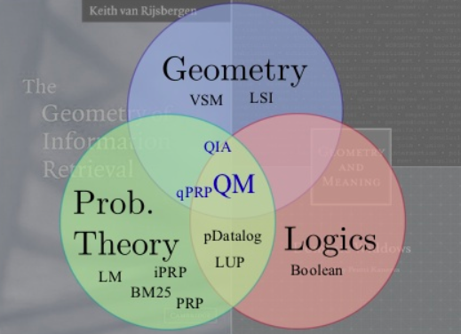
Quantum IR
Quantum Formulism can formulate the different IR models (logic, vector, probabilistic, etc.) in a unified framework.
C.J. van Rijsbergen
SIGIR 2006 Salton Award
[C.J. van Rijsbergen 2004, Geometry of Information Retreival]
[Piwowarski B, et al. What can quantum theory bring to information retrieval. CIKM 2010. 59–68]

Slide 4
Academic impact of QIR
C.J. “Keith” van Rijsbergen. SIGIR Gerard Salton Award 2006
[Zhao et.al.] ECIR 2011 best poster award
[Hou et.al.] ACM ICTIR 2011 Best paper award
[Wang et.al.] ACM SIGIR 2017 Best paper Honorable Mentions (unrelated to Quantum)
[Li et.al.] NAACL 2019 Best explainable NLP paper
[Uprety et.al.] ACM ICTIR 2019 Best Full Paper Honourable mention

Slide 5
Contents
Background
Semantic Hilbert Space—NAACL best explainable NLP paper
Why quantum?
How does it work
Any benefits?
Possible Future works

Slide 6
Why quantum?
There are arguably some connections to link Quantum & NN
Neural Network
[1,2]
Quantum Mechanics
[3,4]
[1] Carleo G, Troyer M. Solving the quantum many-body problem with artificial neural networks[J]. Science, 2017, 355(6325): 602-606.
[2] Gao X, Duan L M. Efficient representation of quantum many-body states with deep neural networks[J]. Nature communications, 2017, 8(1): 662.
[3] Lin X, Rivenson Y, Yardimci N T, et al. All-optical machine learning using diffractive deep neural networks[J]. Science, 2018, 361(6406): 1004-1008.
[4] Levine Y, Yakira D, Cohen N, et al. Deep Learning and Quantum Entanglement: Fundamental Connections with Implications to Network Design[C]. ICLR 2018.
Notes:
改！！！

Slide 7
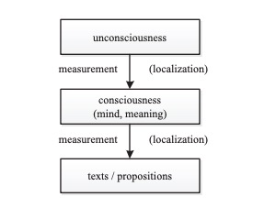
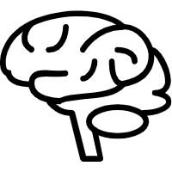

Probability-driven measurement for language
In brain:
It is continuous and uncertainty
In text:
It is discrete and certainty
Linguist tokens are discrete to be stored or spoken,
but the meaning in the mind is continuous and uncertainty.
The left figure is from Xie et.al. Modeling Quantum Entanglements in Quantum Language Models. AAAI 2015.

Slide 8

Probability-driven measurement for language
Writing phrase
A
B
C
measurement
continuous and uncertainty
discrete and certainty

Slide 9

Probability-driven measurement for language
Writing phrase
A
B
C
measurement
continuous and uncertainty
discrete and certainty
Reading phrase
A
B
C
measurement
discrete and certainty
continuous and uncertainty
need a probability theory to describe uncertainty in space continuous e.g. vector spaces

Slide 10

Quantum Probability Theory
a probability theory defining on continuous vector spaces
Classical Probability Theory - discrete and set-based
Q: Should the randomly-chosen cat dead or alive ?
A: 0.4 for the red and 0.6 for the blue
alive
dead

Slide 11


Example - Quantum Probability Theory
a probability theory defining on continuous vector spaces
Classical Probability Theory - discrete and set-based
Q: Should the randomly-chosen cat dead or alive ?
A: 0.4 for the red and 0.6 for the blue
alive
dead
Quantum Probability Theory - continuous and vector-baed
Q: Are these cat dead or alive?
A: 0.4 to be alive and 0.6 to be dead
a single object is simultaneously in many exclusive states with continuous weights
Neural networks usually process the continuous values instead of discrete ones

Slide 12

Probability theory in vector spaces
for single object
$$|e_{2}〉$$
$$H$$
$$|e_{1}〉$$
Projection
Square of the projection length denotes the probability

Slide 13
Probability theory in vector spaces
for many objects
$$|e_{2}〉$$
$$H$$
$$ρ$$
$$|e_{1}〉$$
Square of the projection length denotes the probability

Slide 14
Probability theory in vector spaces
for many objects
$$|e_{2}〉$$
$$H$$
$$ρ$$
$$|e_{1}〉$$
Projection
Square of the projection length denotes the probability

Slide 15
Contents
Background
Semantic Hilbert Space for matching—NAACL best explainable NLP paper
Why quantum?
How does it work
Any benefits?
Possible Future works

Slide 16
Semantic Hilbert Space
Word
Vectors
Word Semantic Composition
High-level Semantic Features
Words
…

Slide 17
Semantic Hilbert Space
Words
a sentence is considered as a bag of words

Slide 18
Semantic Hilbert Space
Word
Vectors
Words
Look up its complex-valued word embedding for each word
A pure state to describe a single particle

Slide 19
Semantic Hilbert Space
Word
Vectors
Word Semantic Composition
Words
Build a density distribution for many words
A mixed state to describe a system with many particles

Slide 20
Semantic Hilbert Space
Word
Vectors
Word Semantic Composition
High-level Semantic Features
Words
…
Use projections to know the system
A probability distribution based on a group of measurements

Slide 21
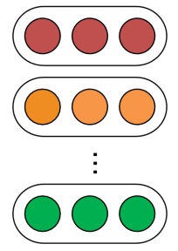
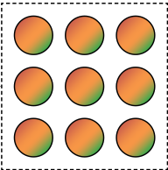

Semantic Hilbert Space
Word
Vectors
Word Semantic Composition
High-level Semantic Features
Words
…
$$\{|w_{i}〉\}$$
$$ρ$$
$$|v_{1}〉$$
$$|v_{2}〉$$
…
$$|v_{k}〉$$
…
Pure States
Mixed State
Measurements

Slide 22
Application to Text Matching
$$ρ_{q}$$
Mixture
Question:
How did women’s role change during the war ?
Answer:
the World Wars started a new era for women’s opportunities to…
$$|v_{1}〉$$
$$|v_{2}〉$$
Measurement
Mixture

Slide 23
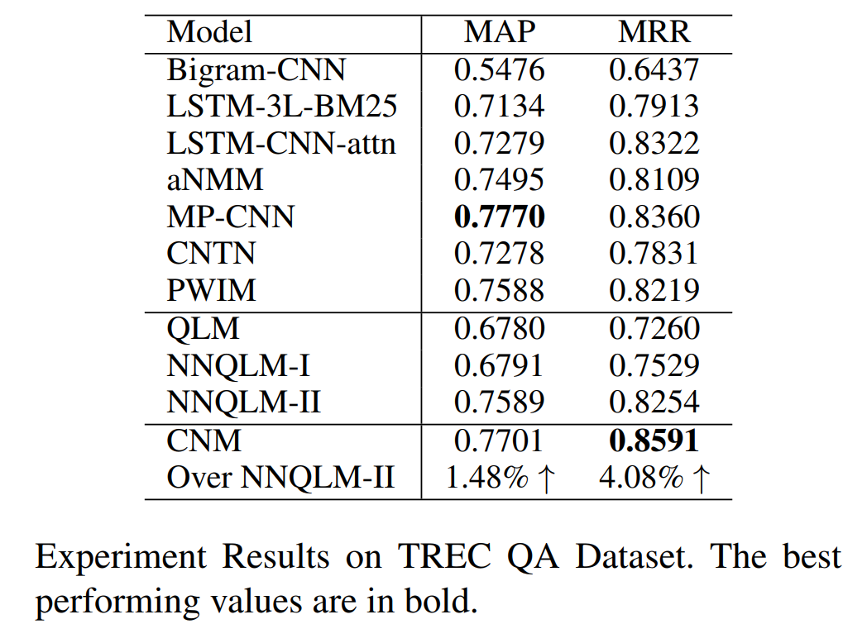
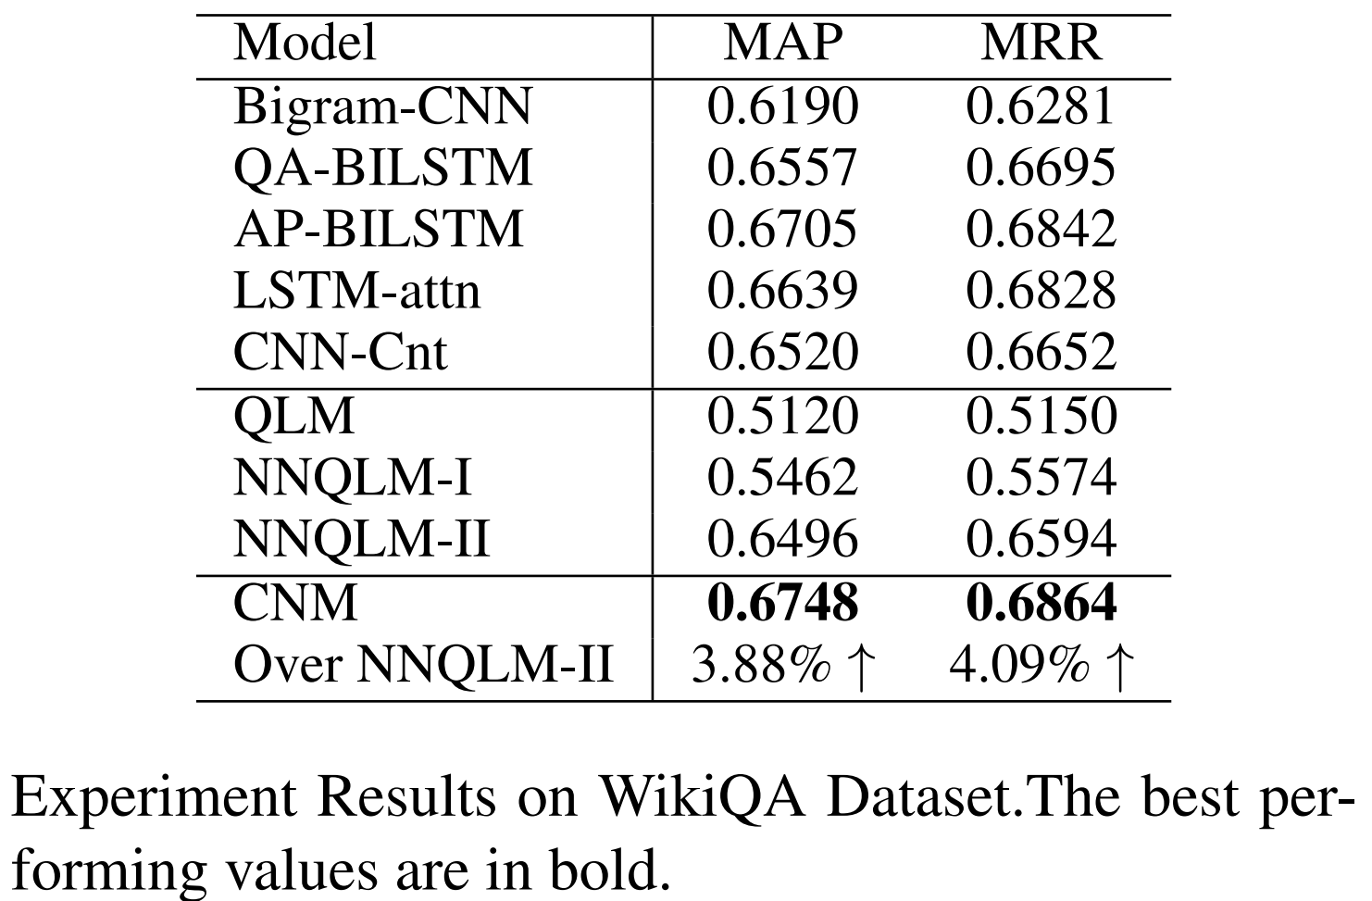
Experiment Result
Effectiveness
Competitive compared to strong baselines
Outperforms existing quantum-inspired QA model (Zhang et al. 2018)
Code : github.com/wabyking/qnn

Slide 24
Contents
Background
Semantic Hilbert Space—NAACL best explainable NLP paper
Why quantum?
How does it work
Any benefits?
understanding distributed representations via superposition
well-mathematically-constrained framework
mutually-interpreted learnable components
Possible Future works

Slide 25
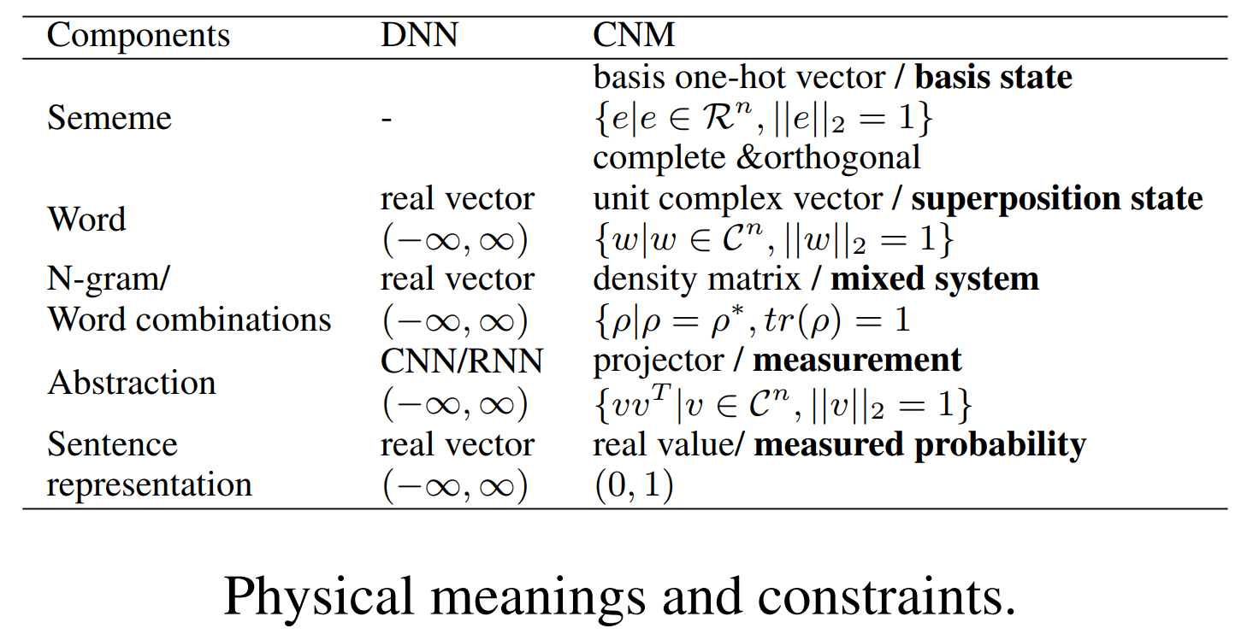
1) Transparency
With well-constraint complex values, CNM components can be explained as concrete quantum states at the design phase

Slide 26
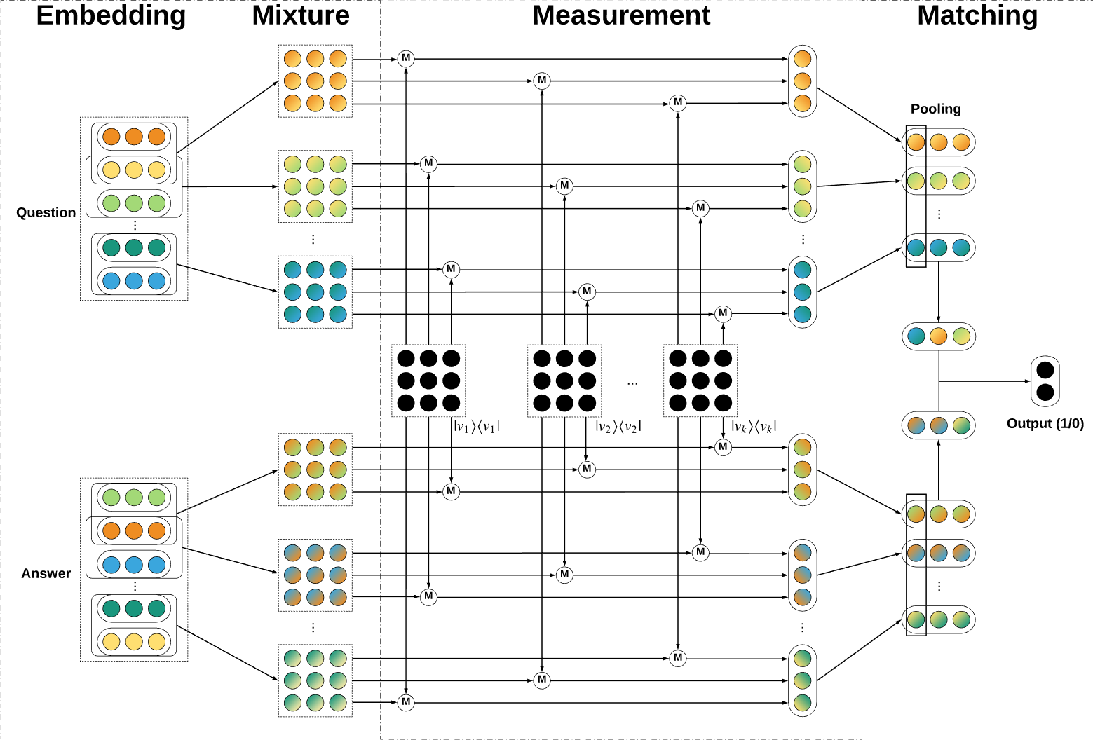
1) Meaning of each neuron
Layer | Embedding | Mixture | Mearurement | Matching
Physical meaning | Pure state | mixed state | measurement | probability
Unitary? | unitary | unitary | unitary | unitary
Complex? | Complex | Complex | Complex | real
Neuron | Probability amplitude for each sememe | Probability correspondence for interaction between two sememes | Probability amplitude for each sememe | probability value for each measurement

Slide 27


2) Distributed representation
as Superposition state
blacksmith
human
occupation
mental
industrial
Reductionism in language:
assume the smallest linguist unit (automatic and indivisible) as Sememe
Words are considered as combination of sememes: like
blacksmith = human + occupation + mental + industrial

Slide 28
2) Why complex-valued weights?
Ivory tower ≠ Ivory + tower
= Ivory + tower +
$$Δ$$

Slide 29
2) Why complex-valued weights?
Ivory tower ≠ Ivory + tower
= Ivory + tower +
$$Δ$$
Complex numerical example:
$$z_{1}=α_{1}+β_{1}i=r_{1}e^{iθ_{1}}.||z_{1}||_{2}=r_{1}^{2}$$
$$z_{2}=α_{2}+β_{2}i=r_{2}e^{iθ_{2}}.||z_{2}||_{2}=r_{2}^{2}$$
$$z_{1}+z_{2}=r_{1}e^{iθ_{1}}+r_{2}e^{iθ_{2}}.||z_{1}+z_{2}||_{2}=r_{1}^{2}+r_{2}^{2}+2r_{1}r_{2}cos(θ_{1}-θ_{2})$$
Interference term

Slide 30
3) A unified Vector space
Measurement
Word
Sememe
Word combination
A unified quantum view of different levels of linguistic units
Sememes
Words
Word Combinations
Sentences
We can interpret the learned measurement by observable words

Slide 31
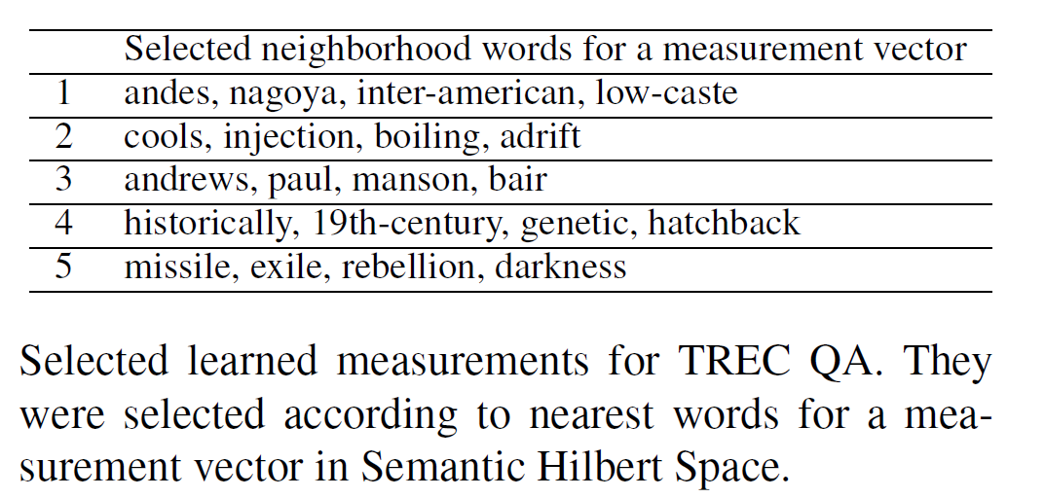
3) Semantic Measurements
Understand measurement via neighbouring words

Slide 32
4) Post-hoc Explainability
Visualisation of word weights and matching patterns
Q: Who is the [president or chief executive of Amtrak] ?
A: ...said George Warrington, [Amtrak ’s president and chief executive].
Q: How did [women ’s role change during the war] ?
A: the [World Wars started a new era for women ’s] opportunities to…

Slide 33
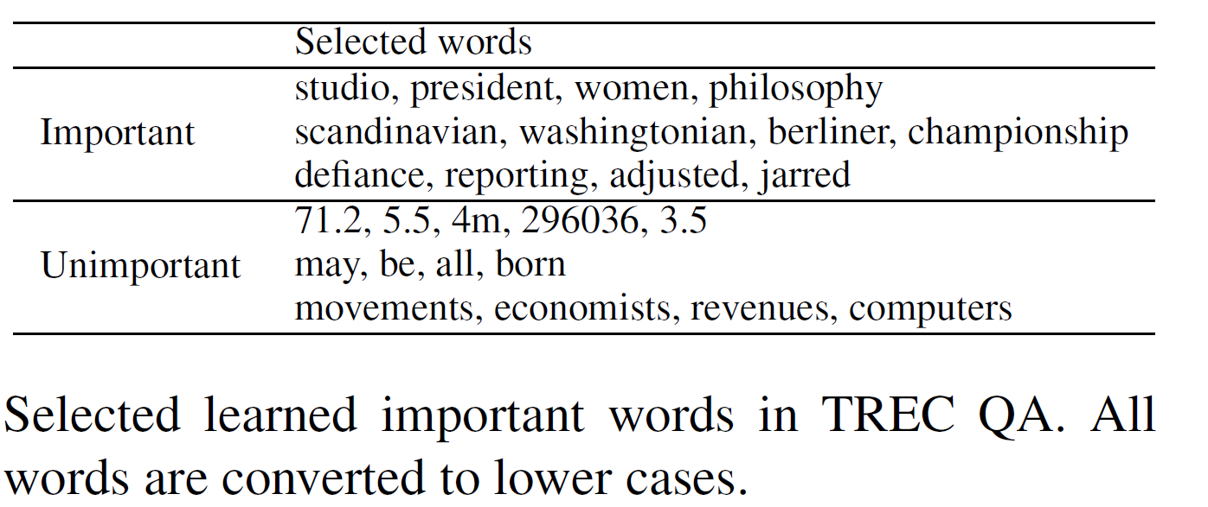
4) explicit term weights
Rank words by l2-norms and select most important and unimportant words

Slide 34
Other Potentials
Robustnees
orthogonal projection subspaces (measurements)
Transferness
Selecting some measurements is a kind of sampling. More measurements, in principle, lead to more accurate inference with respect to the given input. (like ensemble strategy)
Reusing the trained measurement from one dataset to another dataset makes sense, especially that recent works tends to use a given pertained language model to build the input features

Slide 35
Contents
Background
Semantic Hilbert Space—NAACL best explainable NLP paper
Why quantum?
How does it work
Any benefits?
Possible Future works

Slide 36
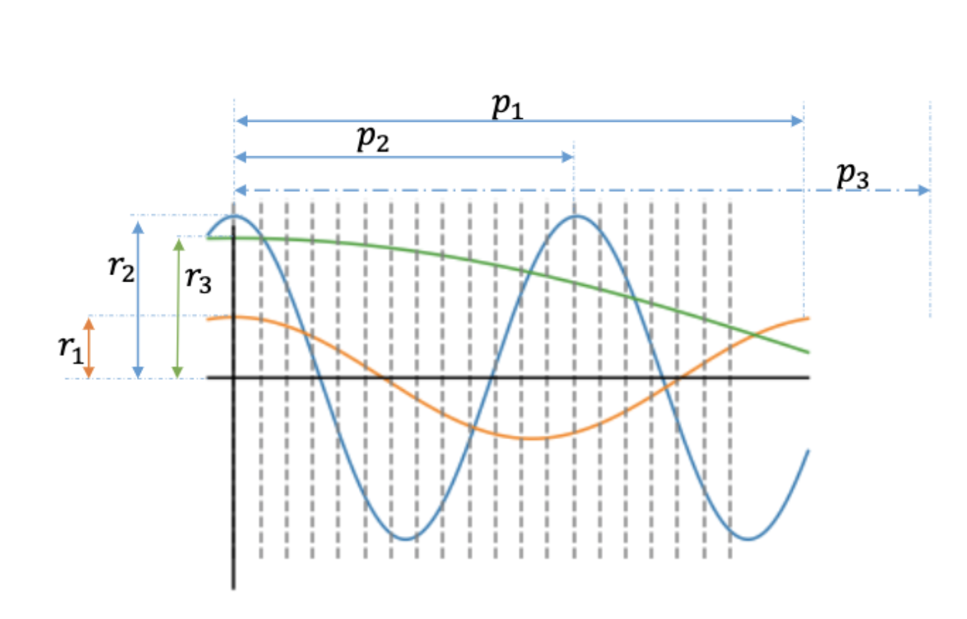
1) Beyond particles：
understanding words as waves
Previous position embedding is either fixed to implicitly capture word order
or trained from scratch without considering word order.
Representing words as wave function can be trained and also capturing word order
Anonymous, Encoding word order in complex embeddings, ICLR 2020 under review. https://openreview.net/forum?id=Hke-WTVtwr

Slide 37
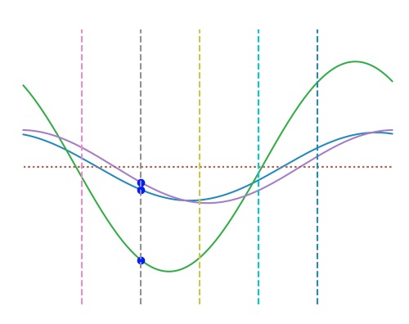
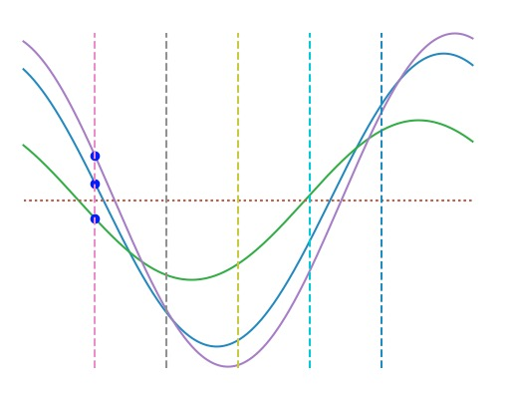
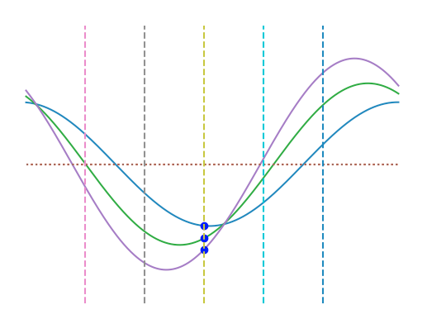
1) Beyond particles：
understanding words as waves
Word functions for ‘I'
Word functions for ‘Iove’
Word functions for ‘Amsterdam’
‘I’ is in the 1st position
‘Iove’ is 2nd
‘Amsterdam’ is 3th
For the sentence ‘I love Amsterdam’

Slide 38
2) Sequencial particles：
Tensor-product representation for language
$$Φ=\overset{⃗}{I}⊗\overset{⃗}{love}⊗\overset{⃗}{Amsterdam}∈R^{N^{3}}$$
For example, to give a binary prediction, we need to train a tensor
$$W∈R^{n^{3}},$$
such that the inner product can get the expected prediction y
$$y=<W.Φ>$$
The next step is to learn a compressed approximation of W via tensor decomposition

Slide 39
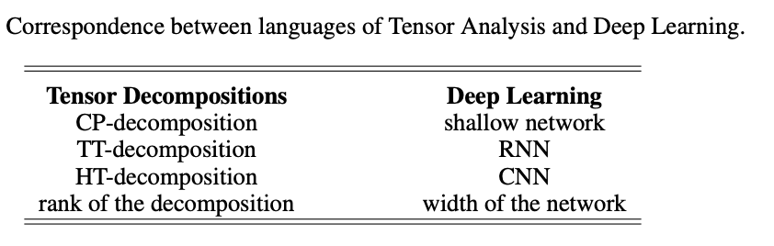
2) Sequencial particles：
Tensor-product representation for language
Tensor decomposition and NN [Cohene et.al. COLT 2016, Valentin et.al. ICLR 2018]
From a tensor-based higher-dimension perspective, we may
Design well-motivated neural networks
Interpret the exciting models
Comparing the expressive power of a neural network via the order the corresponding tensor decomposition can achieve
Cohen, Nadav, Or Sharir, and Amnon Shashua. "On the expressive power of deep learning: A tensor analysis." COLT 2016.
Khrulkov, Valentin, Alexander Novikov, and Ivan Oseledets. "Expressive power of recurrent neural networks." (2018).

Slide 40
3) Evolved particles：
Exploring its dynamics
Model continuous changes of a quantum state by ordinary differential equation
$$i\frac{dϕ}{dt}=Hϕ$$
$$ϕ$$
is a quantum state and H an arbitrary Hermitian operator.
Chen, Tian Qi, et al. "Neural ordinary differential equations." Advances in neural information processing systems. 2018.

Slide 41
References
Li, Qiuchi, Sagar Uprety, Benyou Wang, and Dawei Song. “Quantum-Inspired Complex Word Embedding.” Proceedings of The Third Workshop on Representation Learning for NLP, 2018, 50–57.
Wang, Benyou, Qiuchi Li, Massimo Melucci, and Dawei Song. “Semantic Hilbert Space for Text Representation Learning.” In The World Wide Web Conference, 3293–3299. WWW ’19. New York, NY, USA: ACM, 2019.
Lipton, Zachary C. “The Mythos of Model Interpretability.” Queue 16, no. 3 (June 2018): 30:31–30:57.
Peter D Bruza, Kirsty Kitto, Douglas McEvoy, and Cathy McEvoy. 2008. “Entangling words and meaning”. pages QI, 118–124. College Publications.
Bruza, P.D., and R.J. Cole. “Quantum Logic of Semantic Space: An Exploratory Investigation of Context Effects in Practical Reasoning.” In We Will Show Them! Essays in Honour of Dov Gabbay, 1:339–362. London, UK: College Publications, 2005.
Diederik Aerts and Marek Czachor. “Quantum Aspects of Semantic Analysis and Symbolic Artificial Intelligence.” Journal of Physics A: Mathematical and General 37, no. 12 (2004): L123.
Diederik Aerts and L. Gabora. “A Theory of Concepts and Their Combinations: II.: A Hilbert Space Representation.” Kibernetes 34, no. 1 (2004): 192–221.
Diederik Aerts and L. Gabora. “A Theory of Concepts and Their Combinations I: The Structure of the Sets of Contexts and Properties.” Kybernetes 34 (2004): 167–191.
Diederik Aerts and Sandro Sozzo. “Quantum Entanglement in Concept Combinations.” International Journal of Theoretical Physics 53, no. 10 (October 1, 2014): 3587–3603.
Sordoni, Alessandro, Jian-Yun Nie, and Yoshua Bengio. “Modeling Term Dependencies with Quantum Language Models for IR.” In Proceedings of the 36th International ACM SIGIR Conference on Research and Development in Information Retrieval, 653–662. SIGIR ’13. New York, NY, USA: ACM, 2013.

Slide 42
Thanks!

Slide 43
Roadmap of Quantum IR formal models
Milestones
Quantum Analogy based IR Methods
Double Slit (Zuccon et al. ECIR 2009) Photon Polarization (Zhang, et al. ECIR 2011, ICTIR 2011)
Pros & Cons: + Novel intuitions [ECIR’11 Best Poster Award] - Shallow analogy - Inconsistent with quantum axioms
Quantum Language Models (QLMs)
Original QLM (Sordoni et al. SIGIR 2013) QLM variants (Li, Li, Zhang, SIGIR 2015) (Xie, Hou*, Zhang*, IJCAI 2015)
Pros & Cons: + Consistent with axioms - QLM components are designed separately, instead of learned jointly
Neural Quantum Language Models
End2end QLM for QA (Zhang et al. AAAI 2018) Further variants (Zhang et al. Science China 2018)
Pros & Cons: + Effective joint learning for Question answering; - Lacks inherent connection between NN and QLM - Cannot model complex interaction among words
Credits from Prof. Peng Zhang

Slide 44
Related Works
Quantum-inspired Information Retrieval (IR) models
Query Relevance Judgement (QPRP, QMR,…)
Quantum Language Model (QLM) and QLM variants
Quantum-inspired NLP models
Quantum-theoretic approach to distributional semantics (Blacoe et al. 2013; Blacoe 2015a; Blacoe 2015b)
NNQLM (Zhang et al. 2018)
Quantum Many-body Wave Function (QMWF) (Zhang et al. 2018)
Tensor Space Language Model (TSLM) (Zhang et al. 2019)
QPDN (Li et al. 2018; Wang et al. 2019)

Slide 45

Relationship with Quantum Computing
Quantum Physics
Quantum Computing
Quantum inspired/motivated/enhanced
IR/NLP/ML
Mathematical formulation
Sharing the similar way to probabilistically describe the world

Slide 46
Relationship with Quantum Machine Learning
Classical Machine learning inspired from Physics/Quantum, e.g. Boltzmann machine, Gradient decent
Machine Learning approaches deployed on Quantum computers to speed up the classical machine learning algorithms

Slide 47
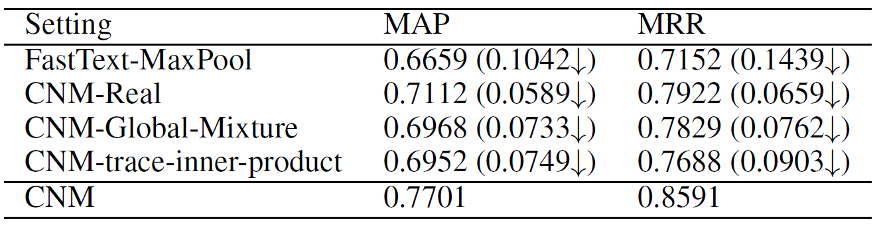
Experiment Result
Ablation Test
Complex-valued Embedding
non-linear combination of amplitudes and phases
Local Mixture Strategy
Trainable Measurement

